Slide 1
CASA0011: Agent-Based Modelling
Dr Sarah WISE
Dr Thomas OLÉRON-EVANS
s.wise@ucl.ac.uk
thomas.evans.11@ucl.ac.uk
Moodle password: ABM20
Centre for Advanced
Spatial Analysis,
90 Tottenham Court Road

Slide 2
LECTURE 9B Traffic Modelling

Slide 3
OBJECTIVES 1. Know the key parameters and variables involved in traffic simulation. 2. Understand the fundamental equations and diagrams of traffic flow. 3. Consider different ways of measuring average speed.

Slide 4
Course Objectives
You should...
1. understand the principles of
agent-based modelling (ABM).
2. be able to describe the type and range of systems to which ABM can be profitably and appropriately applied.
3. be able to conceptualise and model
urban systems with complex dynamics.
4. show evidence of being able to translate your
understanding into the practical methodology of modelling

Slide 5
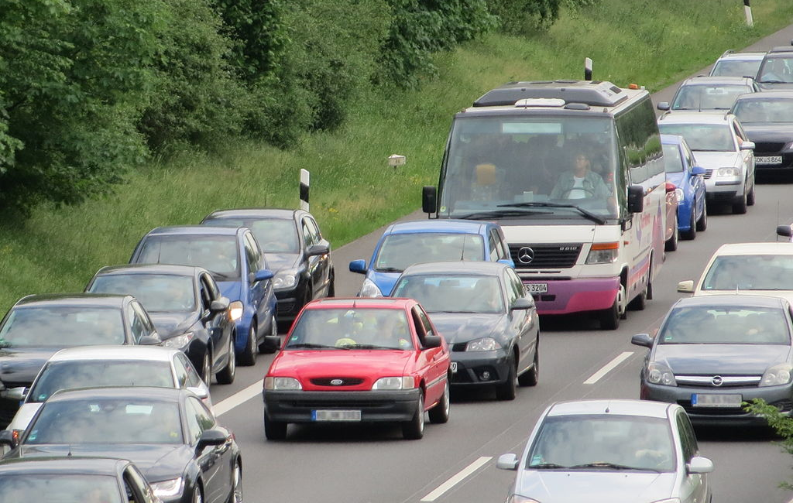
Traffic Modelling
Photo: Public Domain

Slide 6
Key Parameters / Variables
PAUSE

Slide 7
Stable Traffic Flow
Q_{I}
Q_{O}
Inflow
Exogenous Maximum
Outflow
Exogenous Maximum

Slide 8
Stable Traffic Flow
Q_{I}
Q_{O}
Inflow
Exogenous Maximum
Outflow
Exogenous Maximum
Q_{I} = Q_{O}= Q

Slide 9
Unstable Traffic Flow
Shock!
Q_{I}
Q_{O}
Inflow
Exogenous Maximum
Outflow
Exogenous Maximum
Q_{I} ≠ Q_{O}

Slide 10
Stable Traffic Flow
Flow (Q) : Vehicles passing through a road section per unit time (Inflow or Outflow).
Density (D) : Vehicles per unit length
over a section of road.
Speed (V) : Average speed of vehicles
over a section of road.

Slide 11
Stable Traffic Flow
Q_{I}
Q_{O}
Inflow
Exogenous Maximum
Outflow
Exogenous Maximum
Q constant
⇒
V constant
D constant

Slide 12
Stable Traffic Flow
Q_{I}
Q_{O}
Inflow
Exogenous Maximum
Outflow
Exogenous Maximum
Fundamental Equation of Traffic Flow
Q = D V

Slide 13
Stable Traffic Flow
Fundamental Equation of Traffic Flow
Q = D V
Distance / Time
Cars / Time
Cars / Distance

Slide 14
Traffic Flow
PAUSE

Slide 15
Fundamental Diagrams of Traffic Flow
PAUSE

Slide 16
Fundamental Diagrams of Traffic Flow
PAUSE

Slide 17
Fundamental Diagrams of Traffic Flow
PAUSE

Slide 18
Measuring Speed
Q_{Ib}
Q_{Ob}
Q_{Ir}
Q_{Or}
1 km

Slide 19
Measuring Speed
Q_{b}
Q_{b}
Q_{r}
Q_{r}
1 km
Suppose blue and red flows are constant:
Q_{ib} = Q_{Ob} = Q_{b} = 60 cars per hour
Q_{ir} = Q_{Or} = Q_{r} = 60 car per hour

Slide 20
Measuring Speed
Q_{b}
Q_{b}
10 km/h
Q_{r}
60 km/h
Q_{r}
1 km
Speeds and densities are constant but different:
V_{b} = 10 km/h D_{b} = 6 cars per km
V_{r} = 60 km/h D_{r} = 1 cars per km

Slide 21
Measuring Speed
Q_{b}
Q_{b}
10 km/h
Q_{r}
60 km/h
Q_{r}
1 km
What is the average speed?

Slide 22
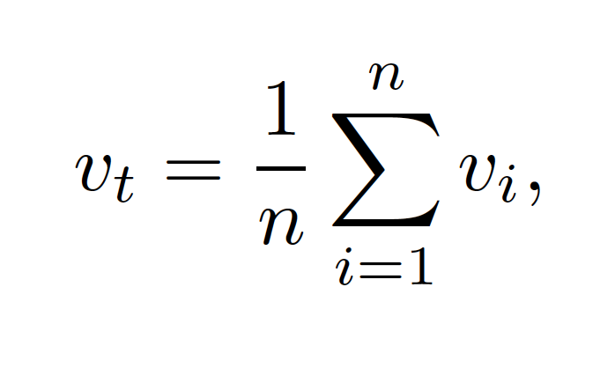
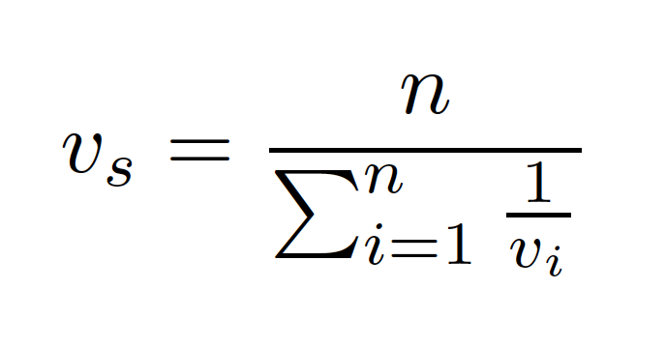
Measuring Speed
Time Mean Speed
Space Mean Speed

Slide 23
Space-Time Diagram

Slide 24
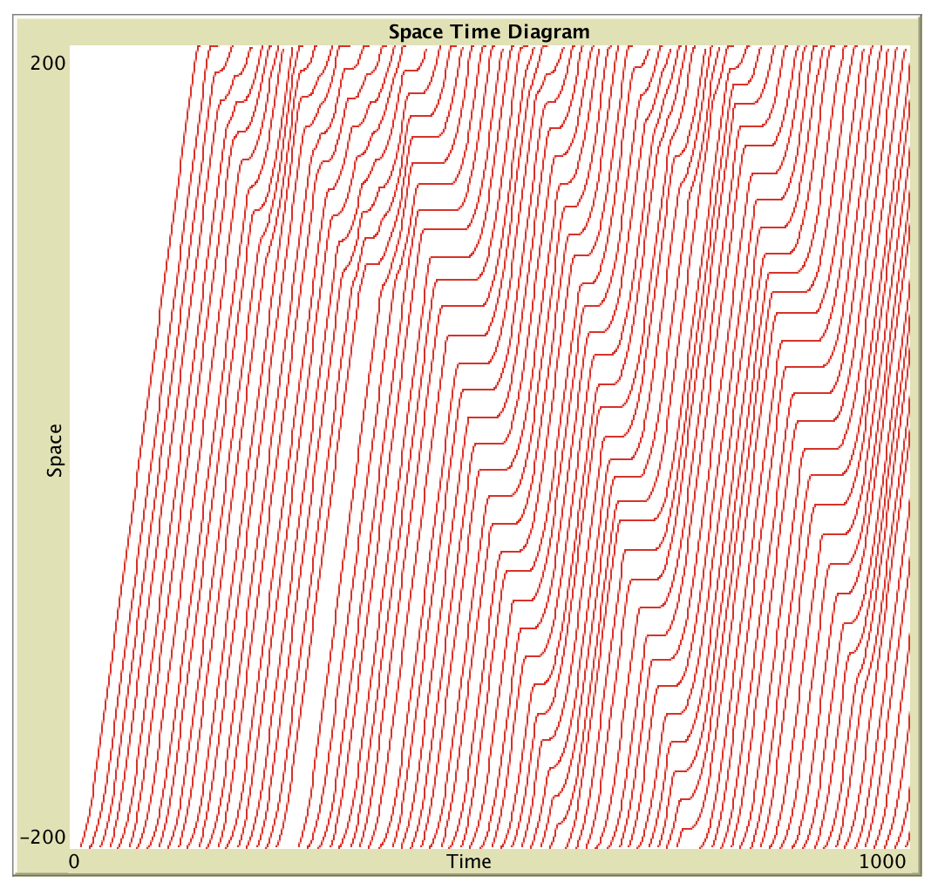
Space-Time Diagram
Gradient = Speed

Slide 25
Space-Time Diagram
Gradient = Speed
Time
Mean
Speed

Slide 26
Space-Time Diagram
Space Mean Speed
Gradient = Speed

Slide 27
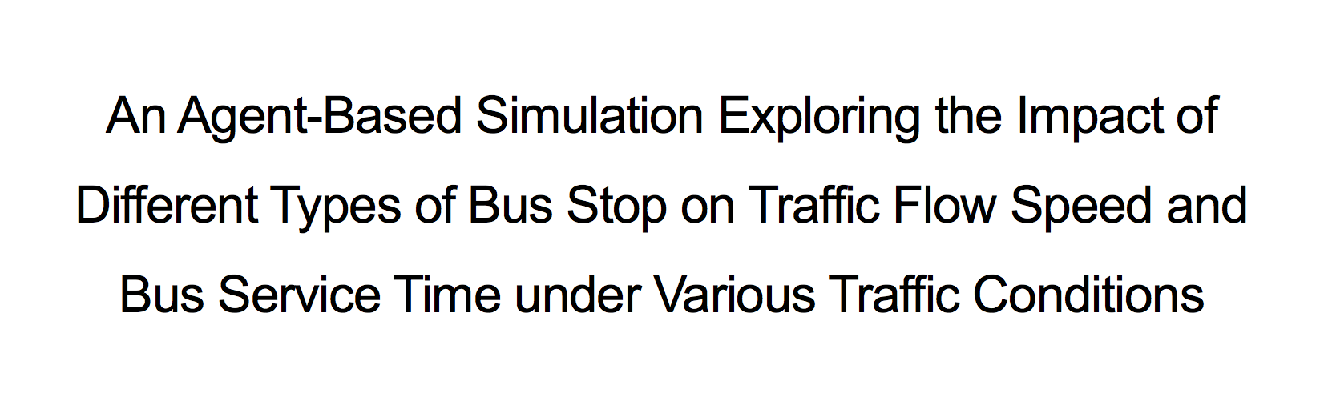
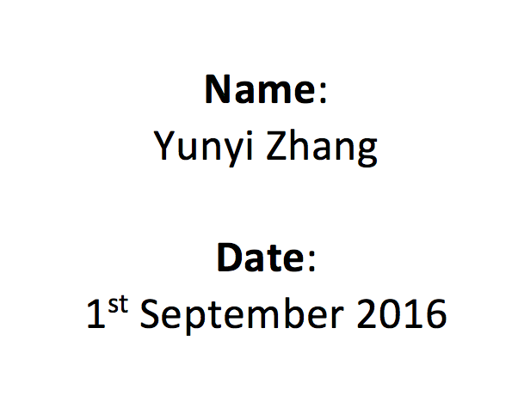
ABM Dissertations

Slide 28
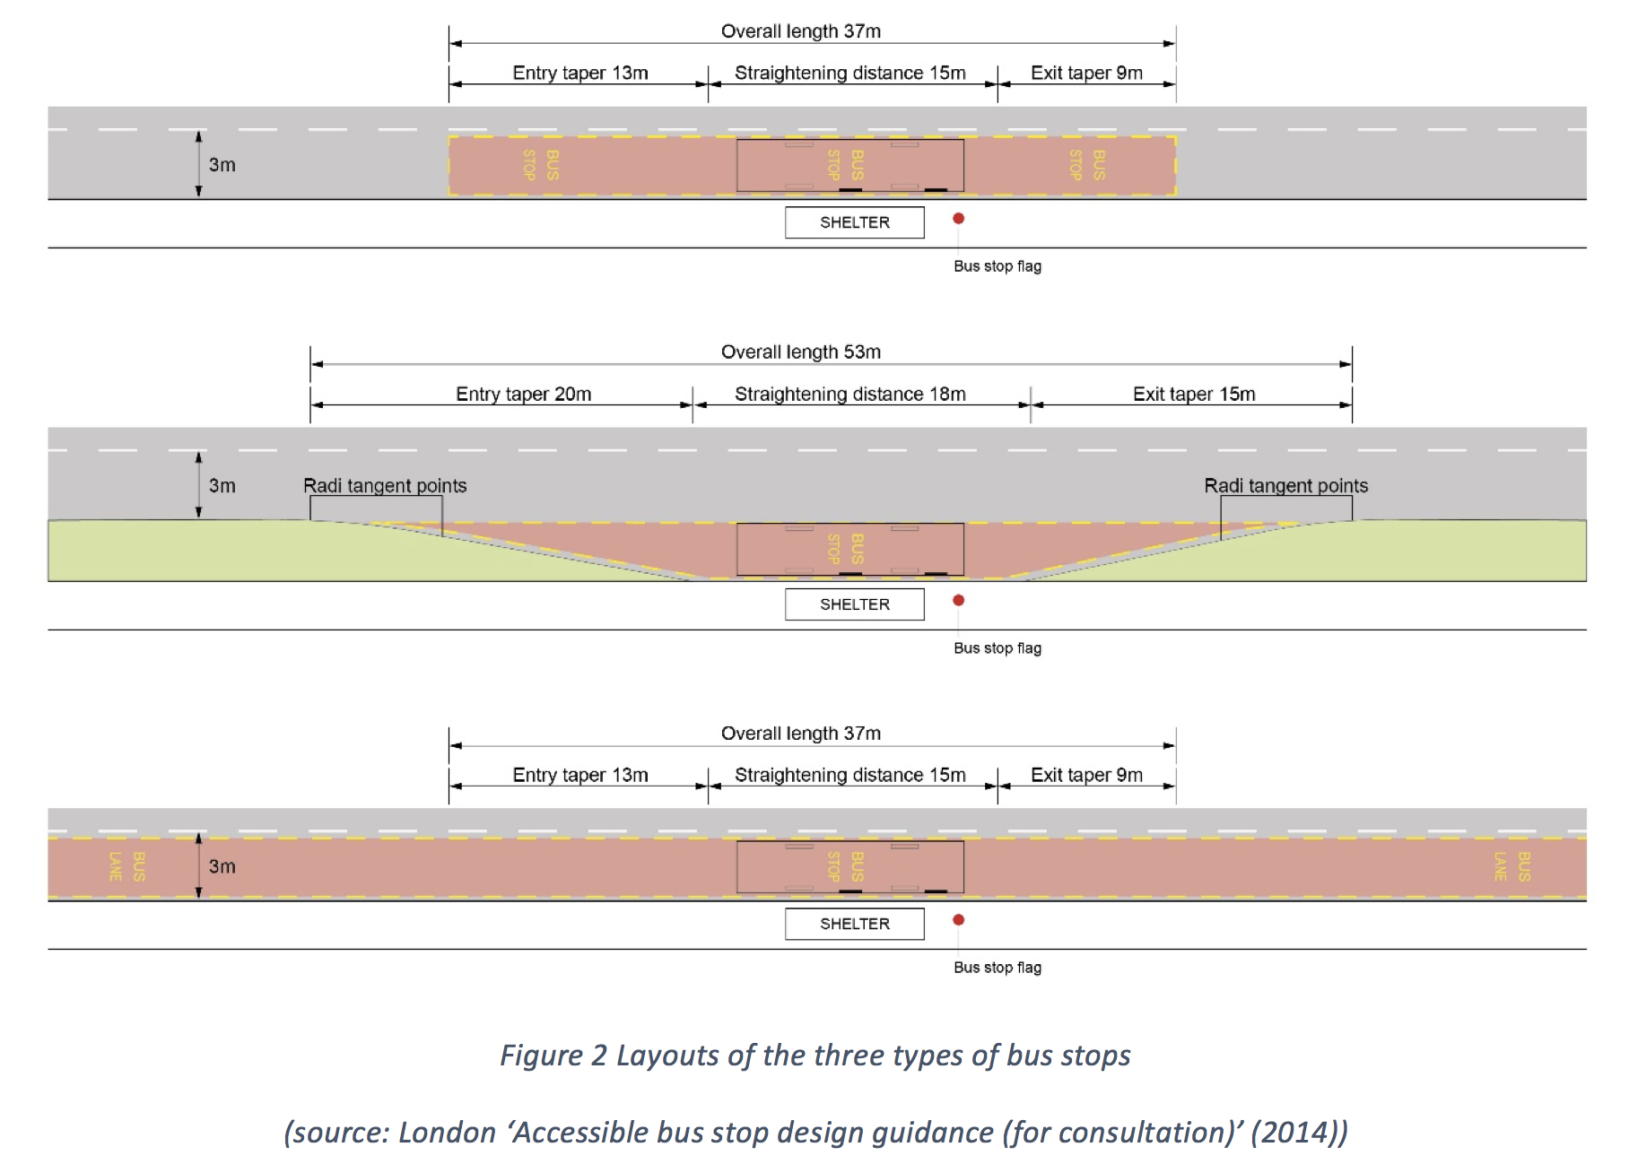

Slide 29
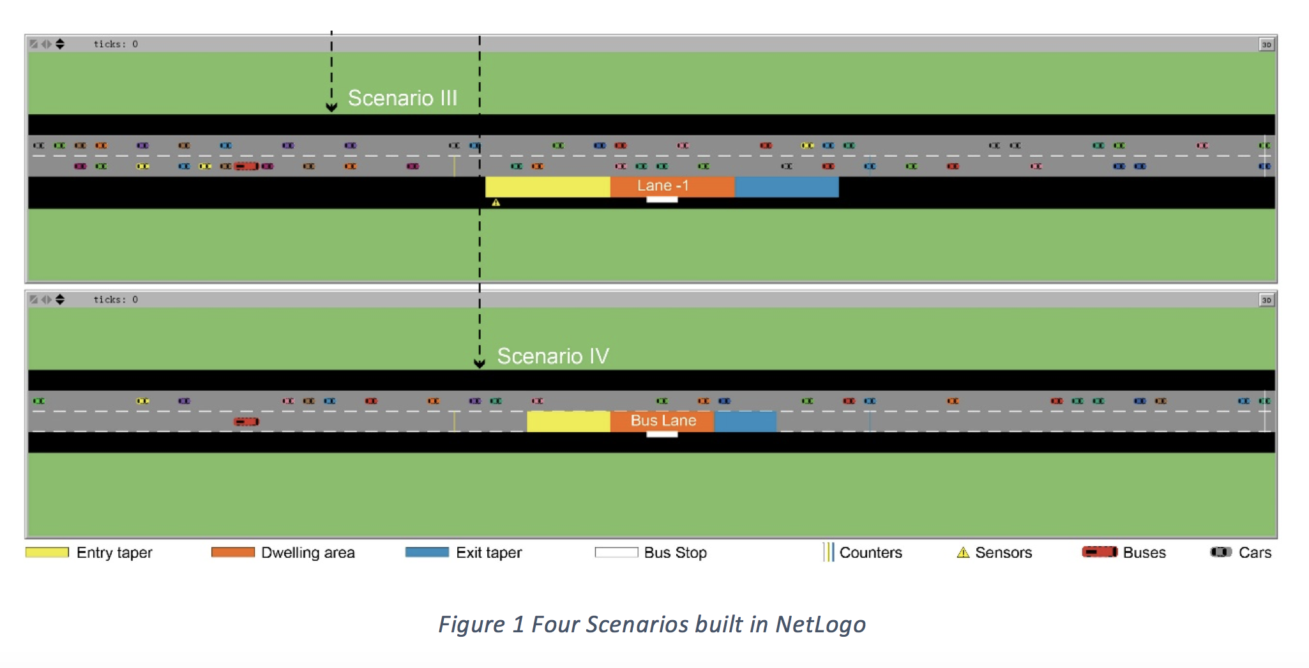

Slide 30
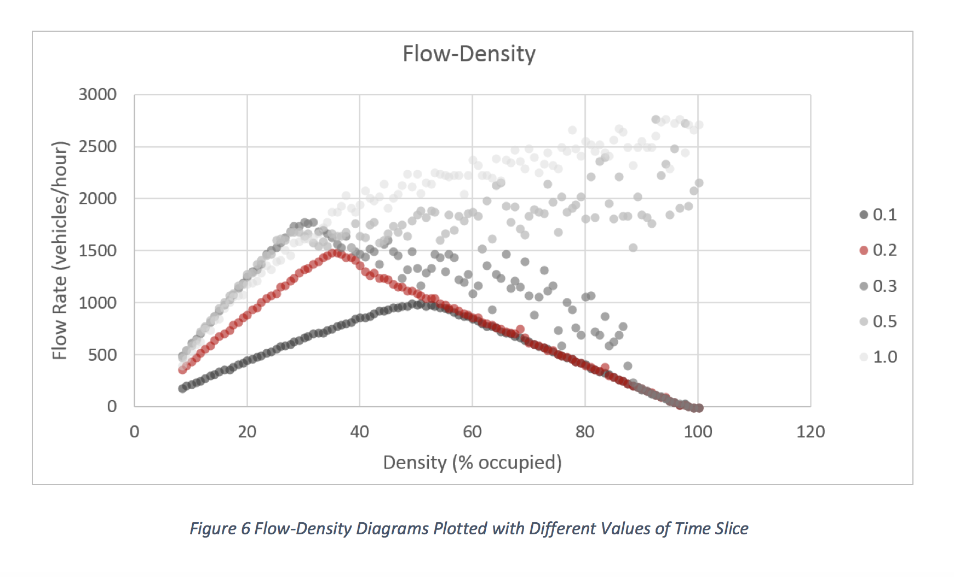

Slide 31
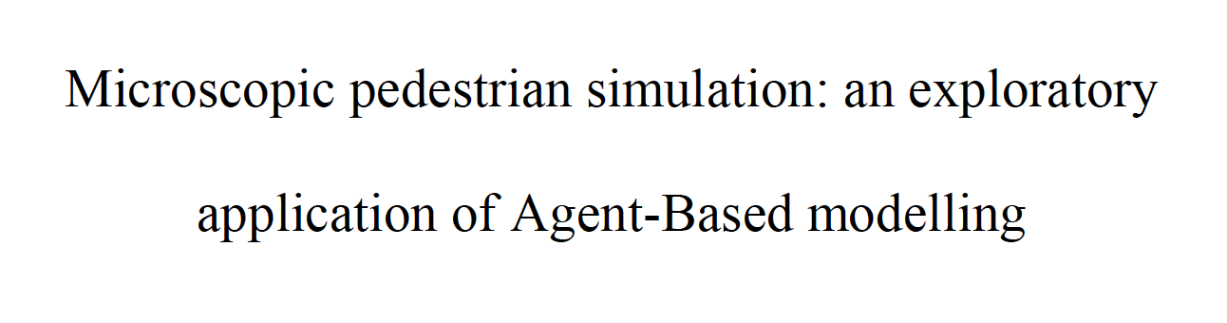
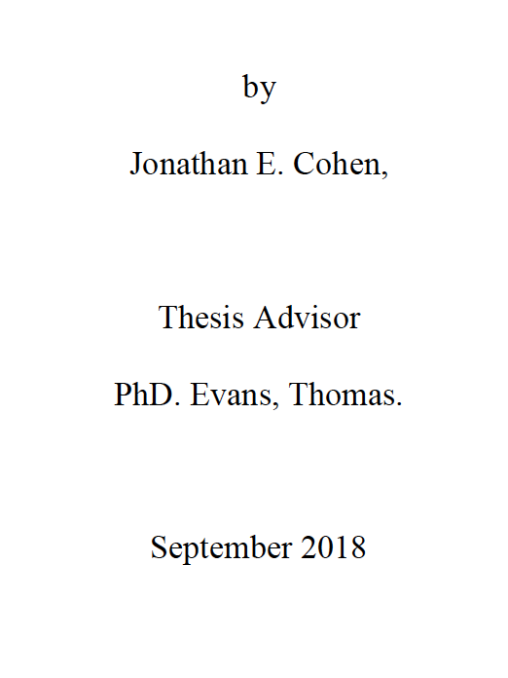
ABM Dissertations

Slide 32
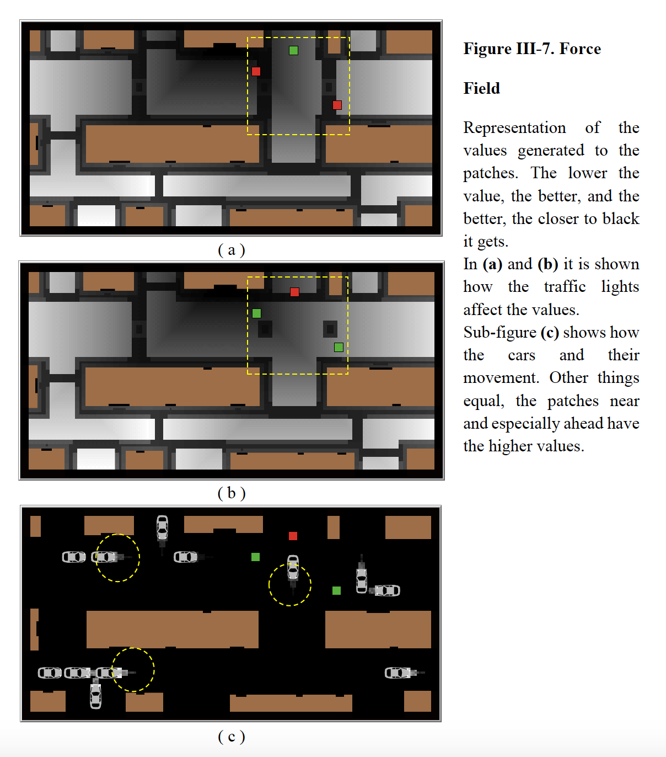
ABM Dissertations

Slide 33
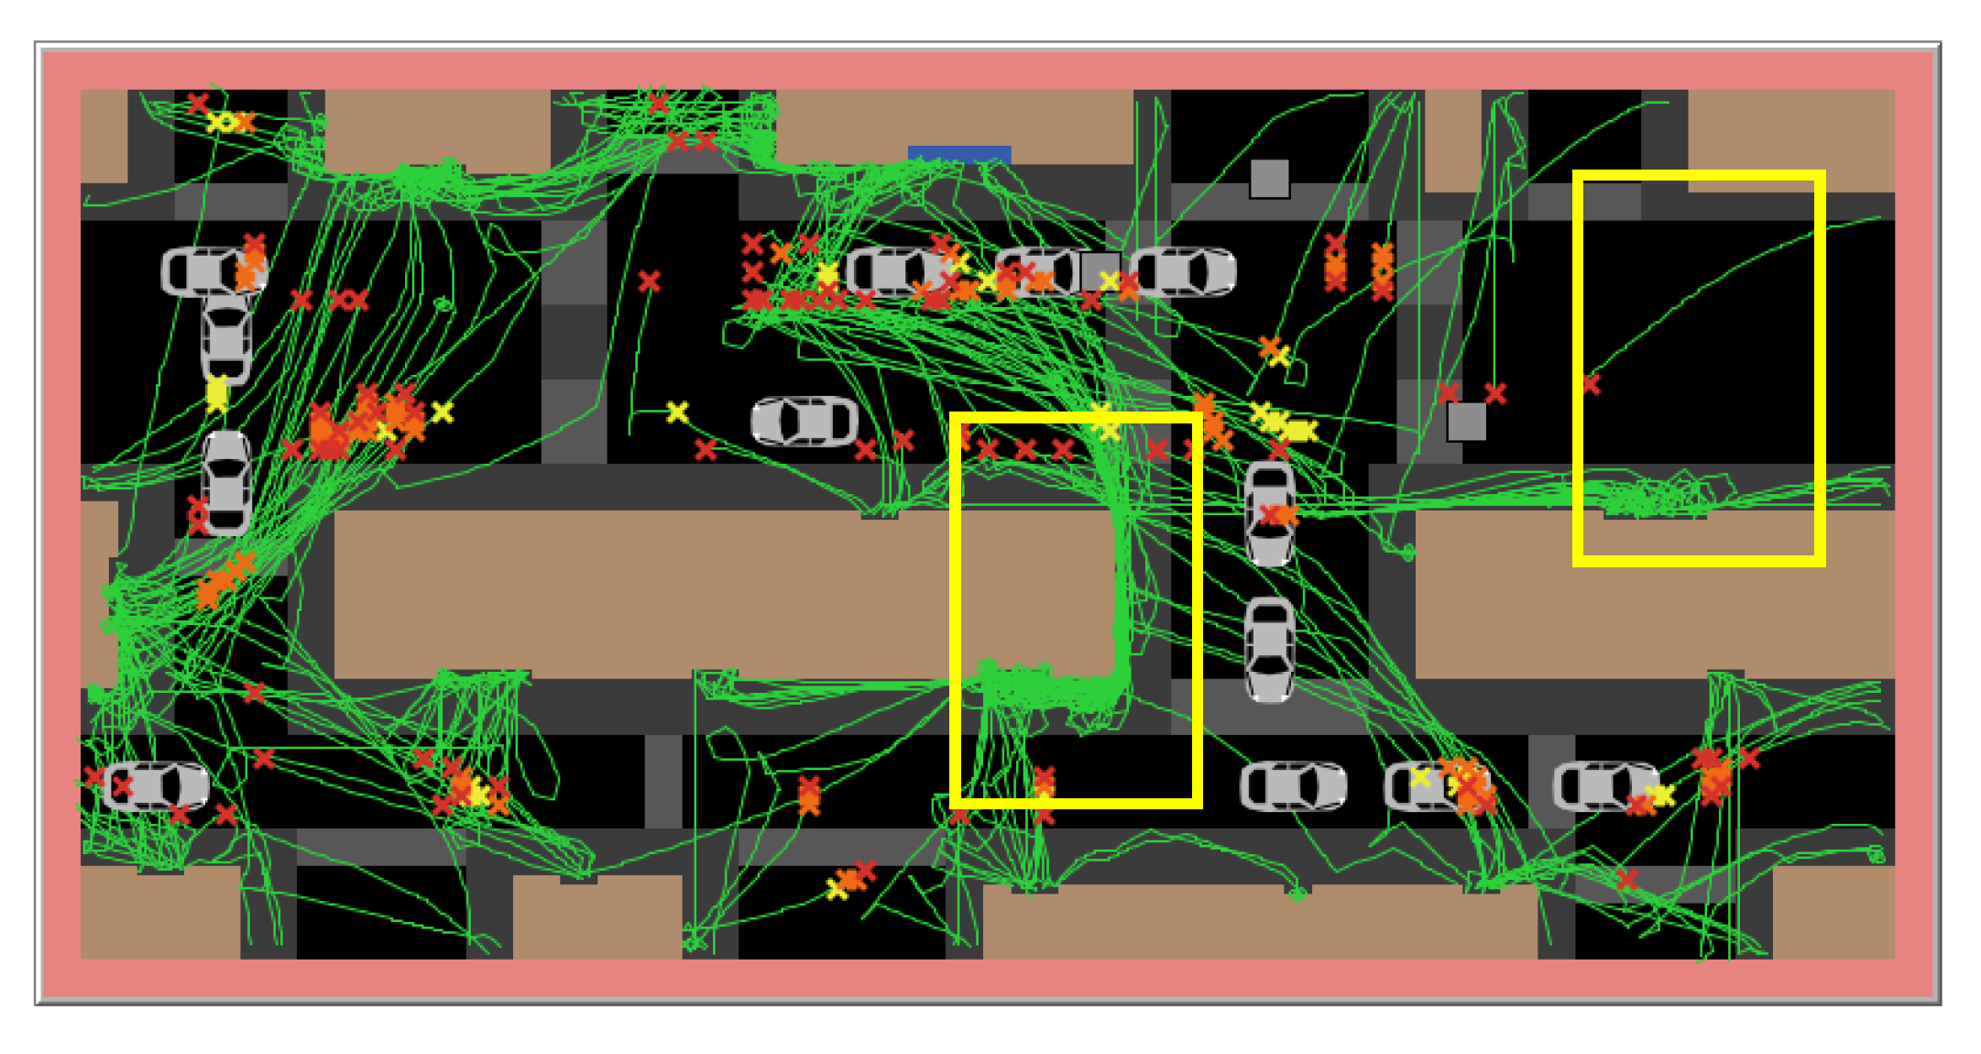

Slide 34
Practicals

Slide 35
OBJECTIVES 1. Know the key parameters and variables involved in traffic simulation. 2. Understand the fundamental equations and diagrams of traffic flow. 3. Consider different ways of measuring average speed.

Slide 36
CASA0011: Agent-Based Modelling
Dr Sarah WISE
Dr Thomas OLÉRON-EVANS
s.wise@ucl.ac.uk
thomas.evans.11@ucl.ac.uk
Moodle password: ABM20
Centre for Advanced
Spatial Analysis,
90 Tottenham Court Road

